Slide 1

Predicting Customer bookings
Prepared by: Arthur Chong

Slide 2
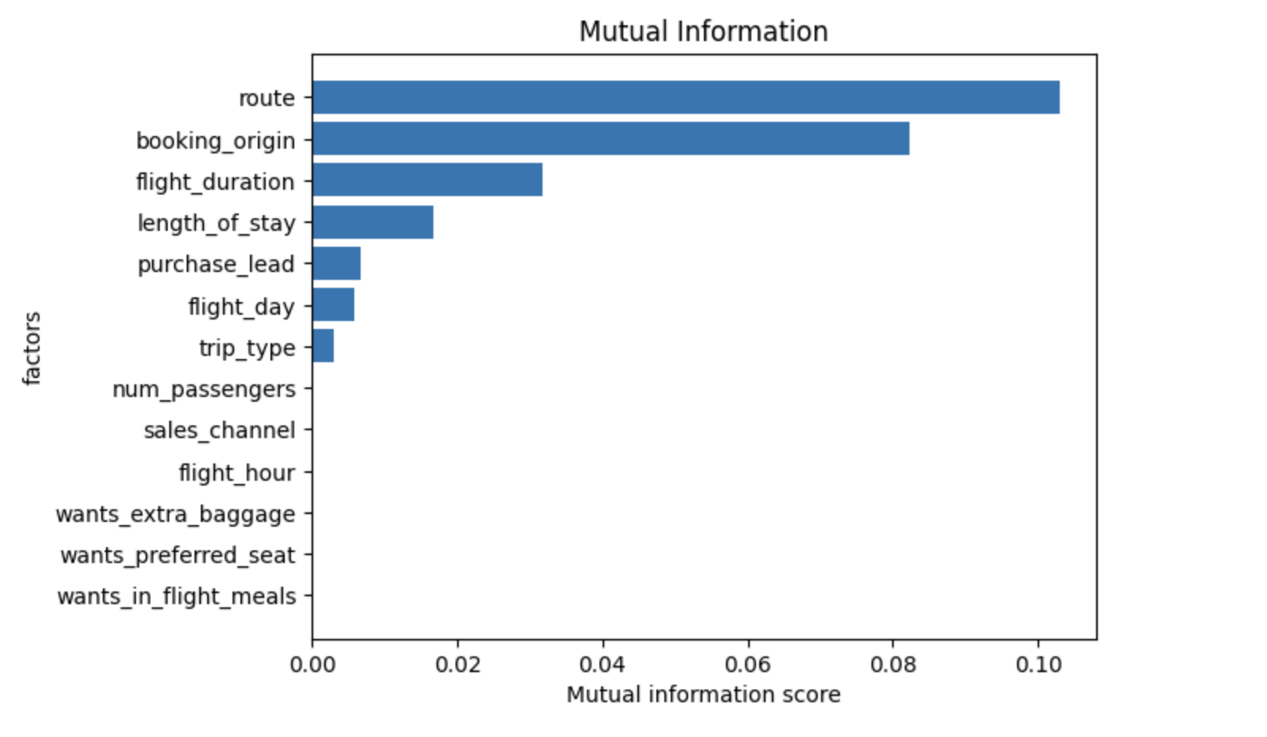
Analysis
The top 3 factors that affect customer booking is
Route
Booking Origin
Flight Duration
Model trained to predict customer booking performed as such:
Accuracy Score : 0.7
AUC Score : 0.7
Improvements to the model can be made by having including more customer demographic features in the dataset

